Slide 1
Recent Advances of Compact Hashing for Large-Scale Visual Search
Shih-Fu Chang
www.ee.columbia.edu/dvmm
Columbia University
December 2012
Joint work with Junfeng He (Facebook), Sanjiv Kumar (Google), Wei Liu (IBM Research), and Jun Wang (IBM Research)

Slide 2
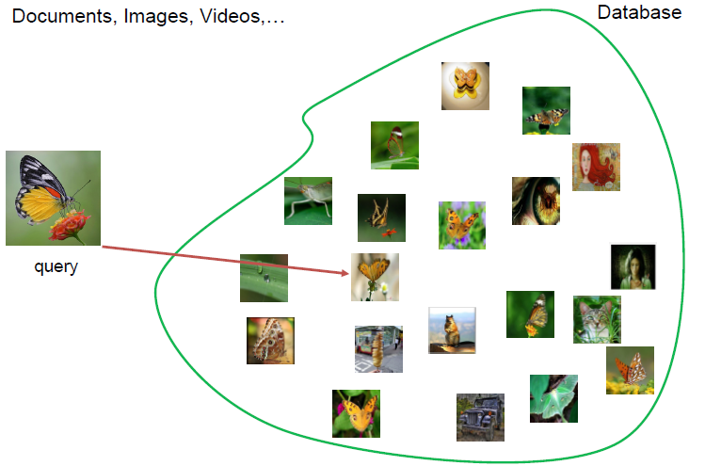
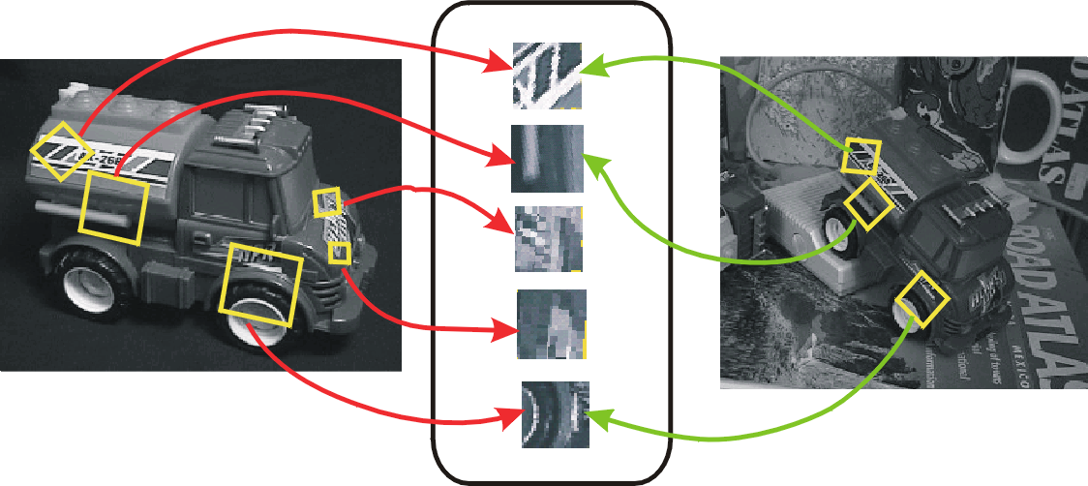
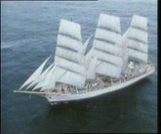
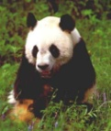
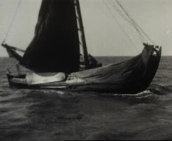
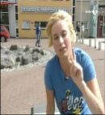
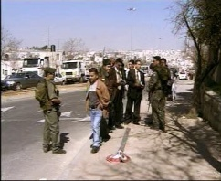

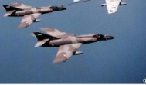

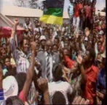

Fast Nearest Neighbor Search
Applications: image retrieval, computer vision, machine learning
Search over millions or billions of data
  Images, local features, other media objects, etc
Database
How to avoid complexity of exhaustive search

Slide 3
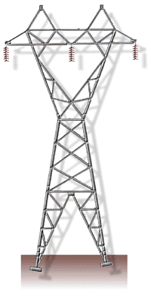
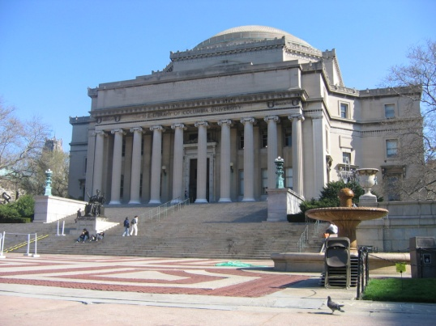
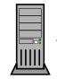
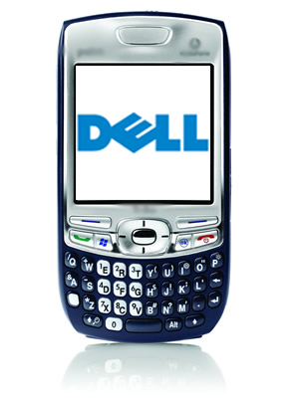





Example: Mobile Visual Search
4. Visual search on server
Image Database
2. Extract local features
3. Send via mobile networks
5. Send results back
1. Take a picture

Slide 4
Challenges for MVS
But need fast response
(< 1-2 seconds)
Large Database
4. Visual matching with database images
Limited bandwidth
Image Database
3. Send via mobile networks
2. Image feature extraction
Limited power/memory/speed
5. Send results back
1. Take a picture

Slide 5
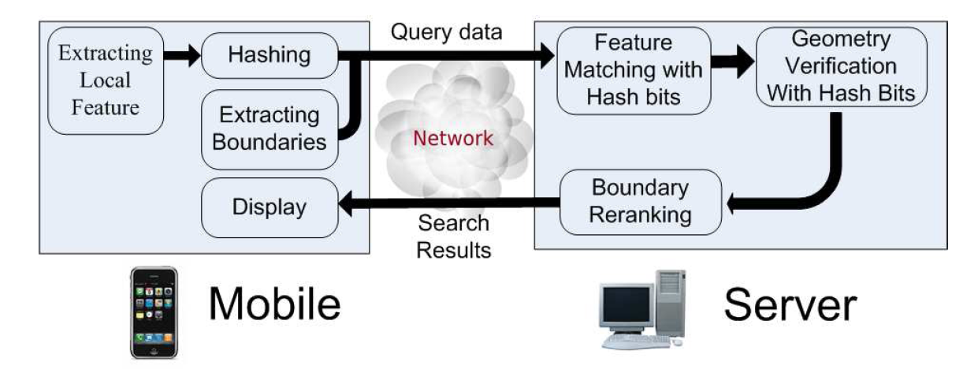
Mobile Search System by Hashing
Low Bit Rate
Light Computing
Big Data Indexing
He, Feng, Liu, Cheng, Lin, Chung, Chang. Mobile Product Search with Bag of Hash Bits and Boundary Reranking, CVPR 2012.

Slide 6
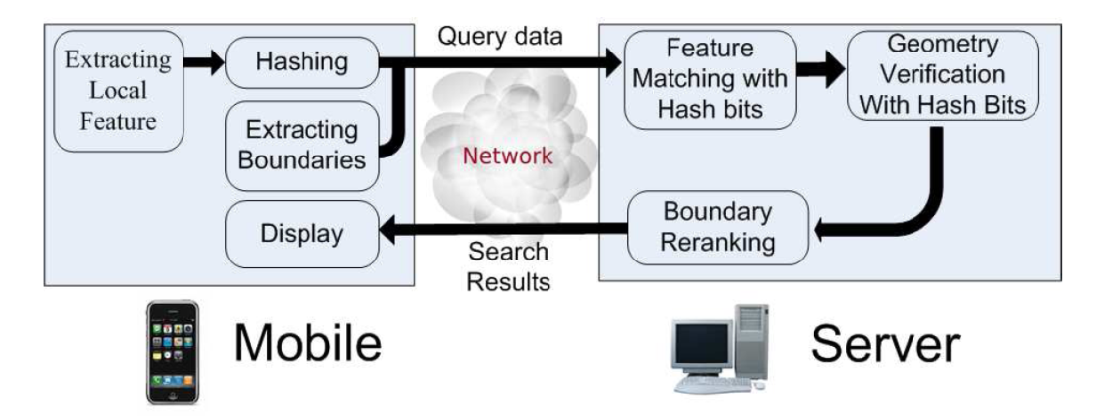
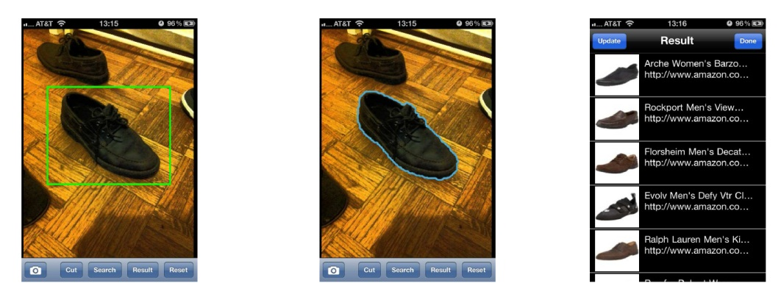
Mobile Product Search System:
Bags of Hash Bits and Boundary features
He, Feng, Liu, Cheng, Lin, Chung, Chang. Mobile Product Search with Bag of Hash Bits and Boundary Reranking, CVPR 2012.
video demo (52, 1:26)
Server:
  ~1 million product images from Amazon, eBay and Zappos
  0.2 billion local features
  Hundreds of categories; shoes, clothes, electrical devices, groceries, kitchen supplies, movies, etc.
Speed
  Feature extraction: ~1s
  Hashing: 0.1s
  Transmission:
  80 bits/feature, 1KB/image
  Server Search: ~0.4s
  Download/display: 1-2s

Slide 7
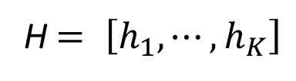
Hash Table based Search
hash table
H $= \left[h_{1}, ⋯,h_{K}\right]$
data bucket
code
n
01100
01101
xi
01110
01111
01101
q
O(1) search time for single bucket
Each bucket stores an inverted file list
Reranking may be needed

Slide 8
Designing Hash Methods
Unsupervised Hashing
Considerations –
Discriminative bits
Non-redundant
Data adaptive?
Use training labels?
Generalize to kernel?
Handle novel data?
LSH ‘98, SH ‘08, KLSH ‘09,
AGH ’10, PCAH, ITQ ’11,
MIndexH ’12
Semi-Supervised Hashing
SSH ‘10, WeaklySH ‘10
Supervised Hashing
RBM ‘09, BRE ‘10,
MLH, LDA, ITQ ‘11, KSH , HML’12

Slide 9

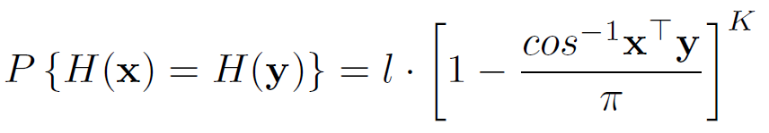
Locality-Sensitive Hashing
[Indyk, and Motwani 1998] [Datar et al. 2004]
0
110
Index by compact code
1
hash function
0
1
random
1
0
Prob(hash code collision) proportional to data similarity
l: # hash tables, K: hash bits per table

Slide 10
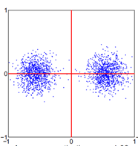
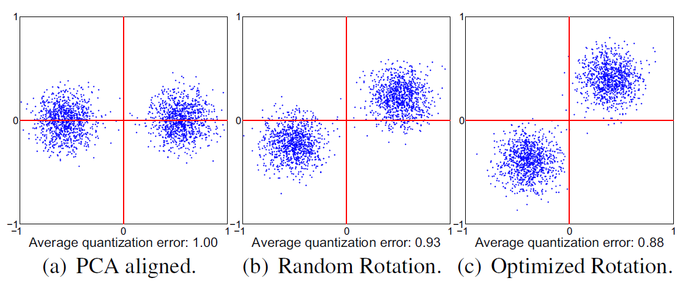
Explore Data Distribution:
PCA + Minimal Quantization Errors
To maximize variance in each hash bit
Find PCA bases as hash projection functions
Rotate in PCA subspace to minimize quantization errors (Gong&Lazebnik ‘11)

Slide 11
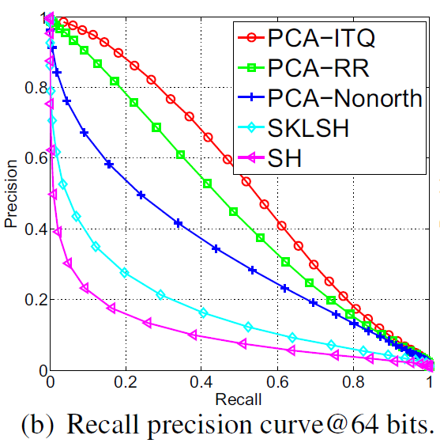
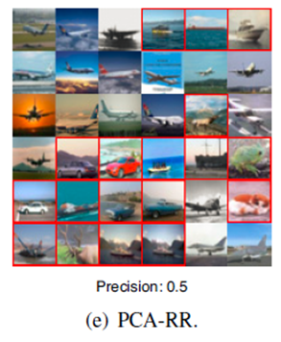
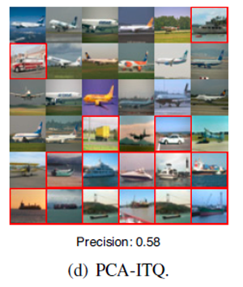
PCA-Hash with minimal quantization error
580K tiny images
PCA-ITQ, Gong&Lazebnik, CVPR 11
PCA-random rotation
PCA-ITQ optimal alignment

Slide 12
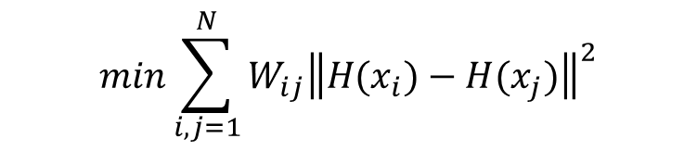
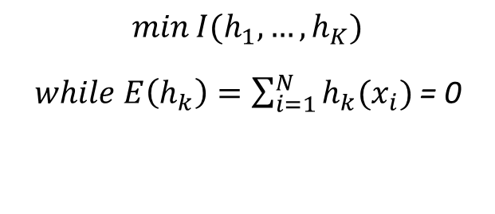
ICA Type Hashing
SPICA Hash, He et al, CVPR 11
Jointly optimize two terms
  Preserve similarity (accuracy)
  min mutual info I between hash bits → Balanced bucket size (search time)
Preserve Similarity
Balanced bucket size
$$\min{\sum_{i,j=1}^{N}{W_{ij}{\left\|H(x_{i})−H(x_{j})\right\|}^{2}}}$$
$$\min{I(h_{1},…,h_{K})}$$
$while E\left(h_{k}\right)=\sum_{i=1}^{N}{h_{k}(x_{i})}$ = 0
Fast ICA to find non-orthogonal projections
Notes:
Can prove the average and worst case search time is minimized if buckets are balanced

Slide 13
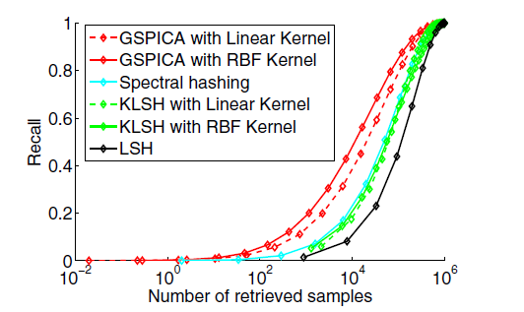
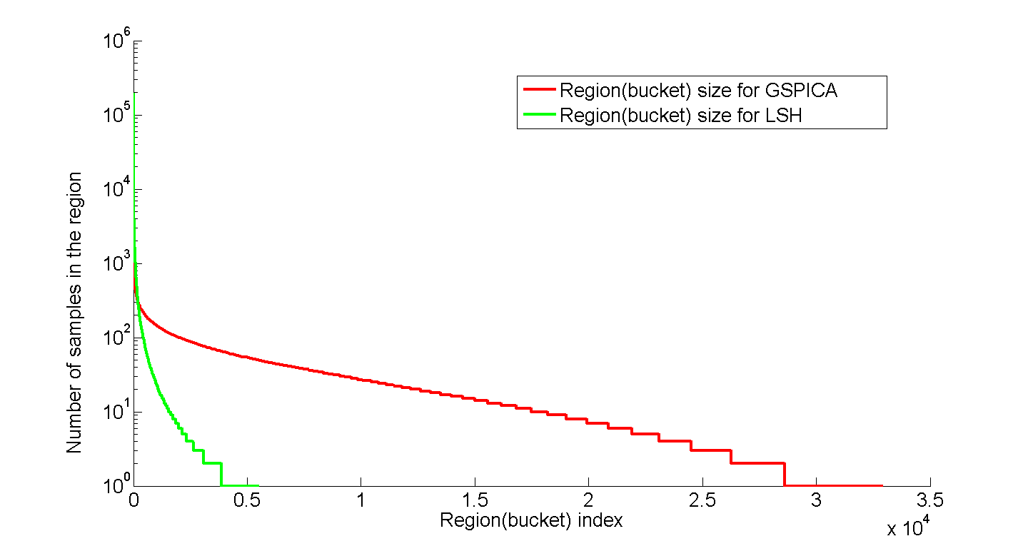
The Importance of balanced size
Simulation over 1M tiny image samples
The largest bucket of LSH contains 10% of all 1M samples
LSH
SPICA Hash
Balanced bucket size
Bucket size
Bucket index
Notes:
32 hash bits

Slide 14
Explore Global Structure in Data
Graph captures global structure over manifolds
Data on the same manifolds hashed to similar codes
Graph-based Hashing
  Spectral hashing
  (Weiss, Torralba, Fergus ‘08)
  Anchor Graph Hashing
  (Liu, Wang, Kumar, Chang, ICML 11)

Slide 15


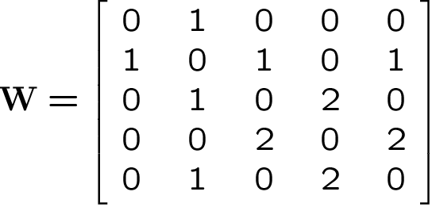




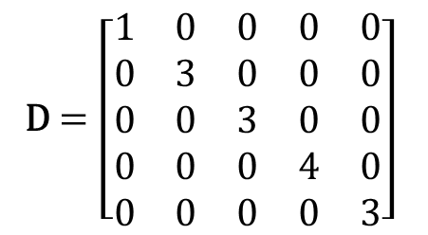
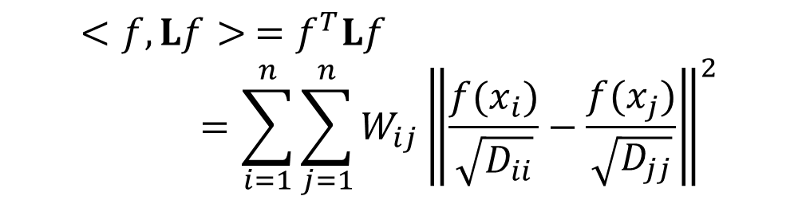
Graph-based Hashing
1
Affinity matrix
Degree Matrix
1
D $=\left[\begin{matrix}1 & 0 & 0 & 0 & 0 \\ 0 & 3 & 0 & 0 & 0 \\ 0 & 0 & 3 & 0 & 0 \\ 0 & 0 & 0 & 4 & 0 \\ 0 & 0 & 0 & 0 & 3\end{matrix}\right]$
1
2
2
  Graph Laplacian , and normalized Laplacian
  smoothness of function f over graph
$$<f,Lf> =f^{T}Lf=\sum_{i=1}^{n}{\sum_{j=1}^{n}{W_{ij}{\left\|\frac{f(x_{i})}{\sqrt{D_{ii}}}−\frac{f(x_{j})}{\sqrt{D_{jj}}}\right\|}^{2}}}$$

Slide 16
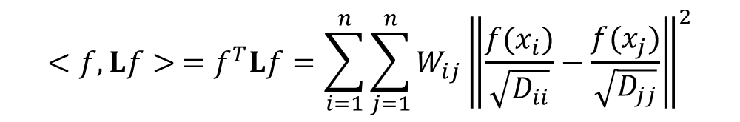
Graph Hashing
Find eigenvectors of graph Laplacian L
$$<f,Lf> =f^{T}Lf=\sum_{i=1}^{n}{\sum_{j=1}^{n}{W_{ij}{\left\|\frac{f(x_{i})}{\sqrt{D_{ii}}}−\frac{f(x_{j})}{\sqrt{D_{jj}}}\right\|}^{2}}}$$
Example:
1st Eigenvector
(binarize: blue: +1, red: -1)
Original Graph (12K)
2rd Eigenvector
3rd Eigenvector
Hash code: [1, 1, 1]
Hard to Achieve by conventional tree or clustering methods

Slide 17
Scale Up to Large Graph
When graph size is large (million – billion)
  Hard to construct/store graph (kN²)
  Hard to compute eigenvectors

Slide 18

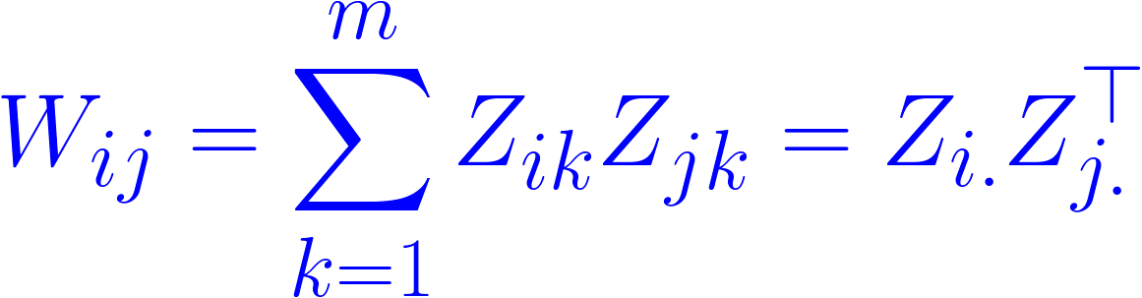
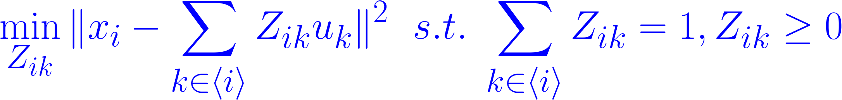
Idea: Build low-rank graph via anchors
(Liu, He, Chang, AGH, ICML10)
Use anchor points to “abstract” the graph structure
Compute data-to-anchor similarity: sparse local embedding
Data-to-data similarity W = inner product in the embedded space
W18>0
x8
x1
Z16
Z11
u6
anchor points
Z12
u1
W14=0
u5
u2
u4
u3
x4
data points
Notes:
Z captures data-to-anchor similarities.

Slide 19
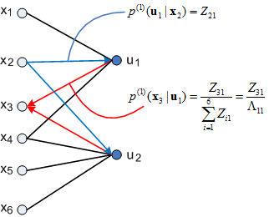
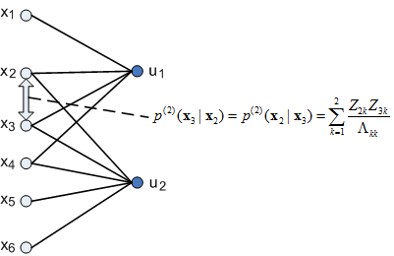
Probabilistic Intuition
Affinity between samples i and j, Wij
= probability of two-step Markov random walk
AnchorGraph: sparse, positive semi-definite
Notes:
<i> is the index set including indexes of s closest anchors of x_i. K is a predefined kernel function, e.g., Gaussian.

Slide 20

Anchor Graph
Affinity matrix W: sparse, positive semi-definite, and low rank
Eigenvectors of graph Lapalcian can be solved efficiently in the low-rank space
Hashing of novel data: sgn(Z(x)E)
$$E= \left\{e_{1},⋯,e_{K}\right\}∈R^{m×K}$$
Hash functions
$$H_{n×K}=\left\{h_{1},⋯,h_{K}\right\}=Z_{n×m}E_{m×K}$$

Slide 21
Example of Anchor Graph Hashing
Original Graph (12K points)
1st Eigenvector
(blue: +1, red: -1)
2rd Eigenvector
3rd Eigenvector
Anchor Graph (m=100 anchors)
Anchor graph hashing allows computing eigenvectors of gigantic graph Laplacian
Approximate well the exact vectors

Slide 22
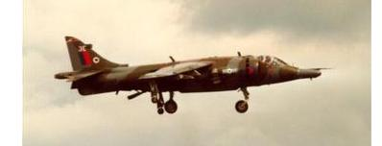
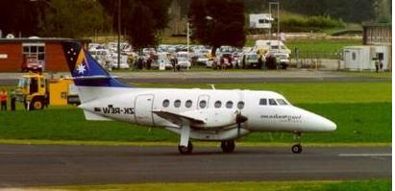

Utilize supervised labels
Semantic Category Supervision
Metric Supervision
similar
dissimilar
dissimilar
dissimilar
similar

Slide 23

Design Hash Codes to Match Supervised Information
similar
dissimilar
1
Preferred hashing function
0

Slide 24



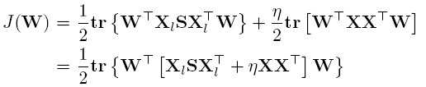
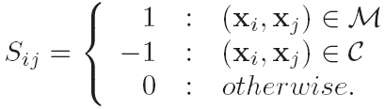
Adding Supervised Labels to PCA Hash
Wang, Kumar, Chang, CVPR ’10, ICML’10
similar pair
dissimilar pair
Relaxation:
Fitting labels
PCA covariance matrix
“adjusted” covariance matrix
solution W: eigen vectors of adjusted covariance matrix
If no supervision (S=0), it is simply PCA hash
Notes:
Extension to non-orthogonal, add a regularization term |WtW – I| to the objective function

Slide 25
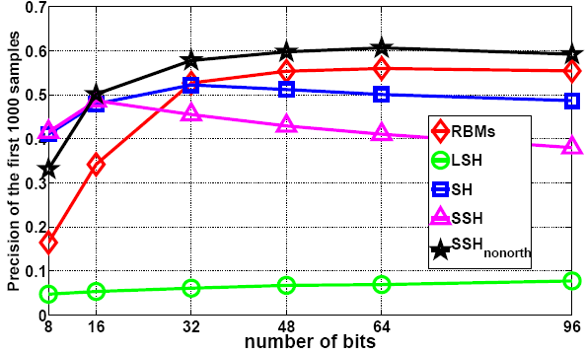
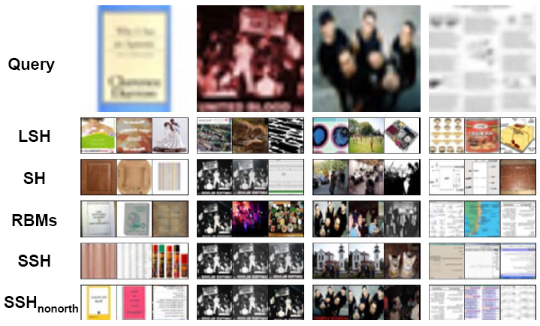
Semi-Supervised Hashing (SSH)
1 Million GIST Images
1% labels, 99% unlabeled
Precision @ top 1K
SSH
Supervised RBM
Unsupervised SH
Random LSH
Reduce 384D GIST to 32 bits
Notes:
RBM: Restrictive Boltzman Machine

Slide 26
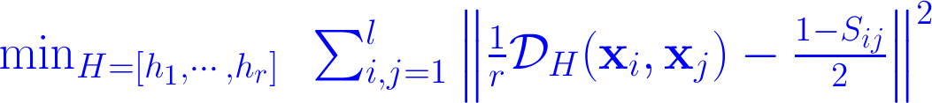
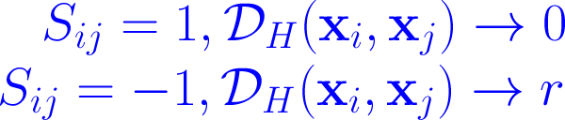
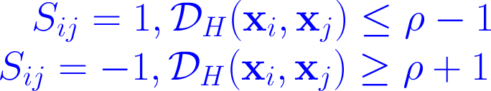




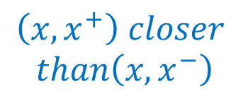
Supervised Hashing
Hamming distance between
H(xi) and H(xj)
BRE [Kulis & Darrell, ‘10]
hinge loss
Minimal Loss Hash [Norouzi & Fleet, ‘11]
Kernel Supervised Hash (KSH) [Liu&Chang ‘12]
HML [Norouzi et al, ‘12] ranking loss in triplets
$$\left(x, x^{+}\right) closer$$
$$than\left(x, x^{−}\right)$$
Notes:
Binary Reconstruction Embedding (BRE)
Minimal Loss Hashing (MLH): use structured learning
KSH can be easily extended to kernel

Slide 27
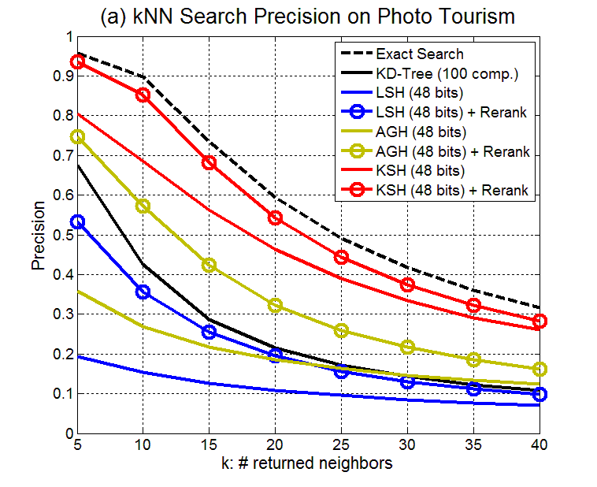
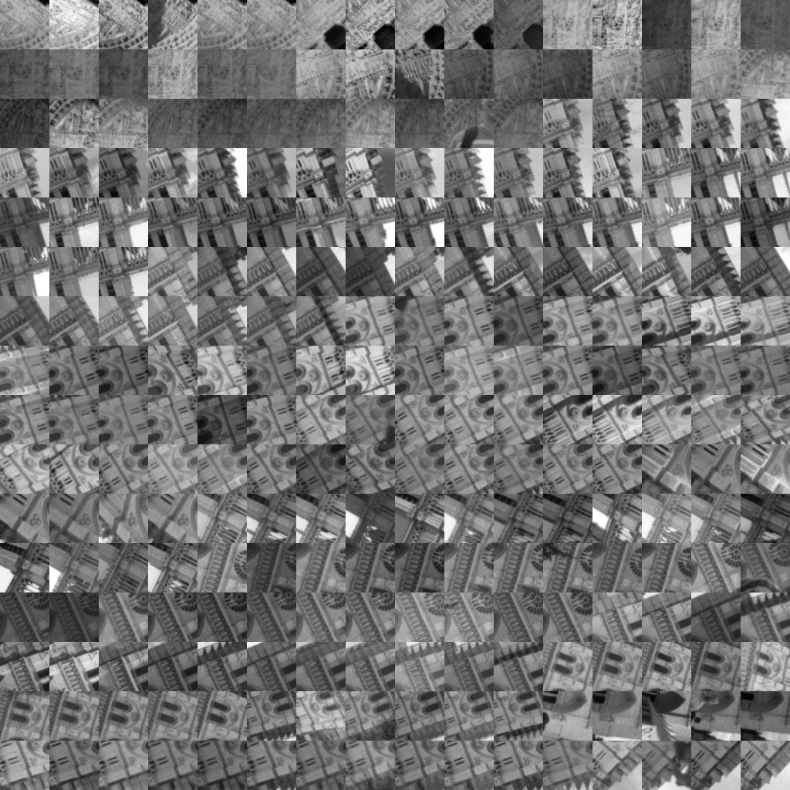
Comparison of Hashing vs. KD-Tree
Photo Tourism Patch (Norte Dame subset, 103K samples)
512 dimension features
KD Tree
Supervised Hashing
Anchor Graph
Hashing
Notes:
Each patch 64x64 pixels
2% labels

Slide 28
Comparison of Hashing vs. KD-Tree
Method | Exact | KD-Tree |  | LSH |  | AGH |  | KSH
 |  | 100 comp. | 200 comp. | 48 bits | 96 bits | 48 bits | 96 bits | 48 bits | 96 bits
Time /query (sec) | 1.02 e-2 | 3.01 e-2 | 3.23 e-2 | 1.22 e-4 | 1.35 e-4 | 1.54 e-4 | 1.99 e-4 | 1.57 e-4 | 2.05 e-4
Method | LSH + top 0.1% L2 rerank |  | AGH+ top 0.1% L2 rerank |  | KSH+ top 0.1% L2 rerank
 | 48 bits | 96 bits | 48 bits | 96 bits | 48 bits | 96 bits
Time /query (sec) | 1.32 e-4 | 1.45 e-4 | 1.64 e-4 | 2.09 e-4 | 1.67 e-4 | 2.15 e-4

Slide 29
Other Hashing Forms

Slide 30
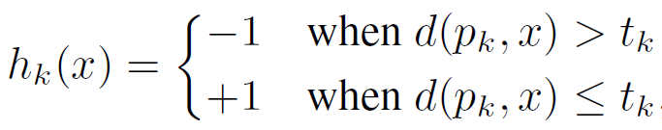
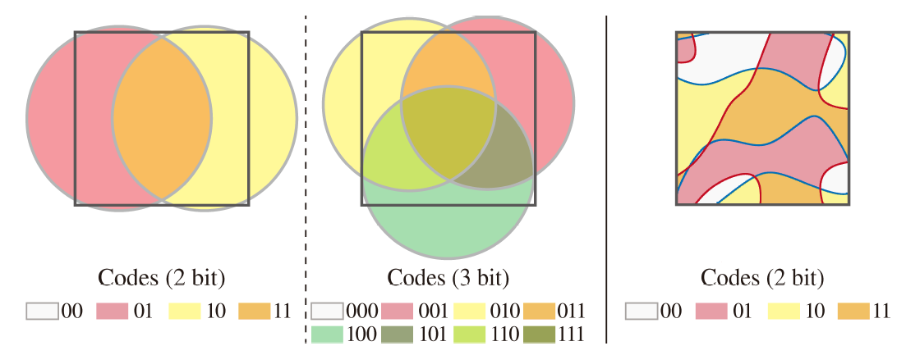
Spherical Hashing
Heo, Lee, He, Chang, Yoon, CVPR 2012
linear projection -> spherical partitioning
Asymmetrical bits: matching hash bit +1 is more important
Learning: find optimal spheres (center, radius) in the space

Slide 31
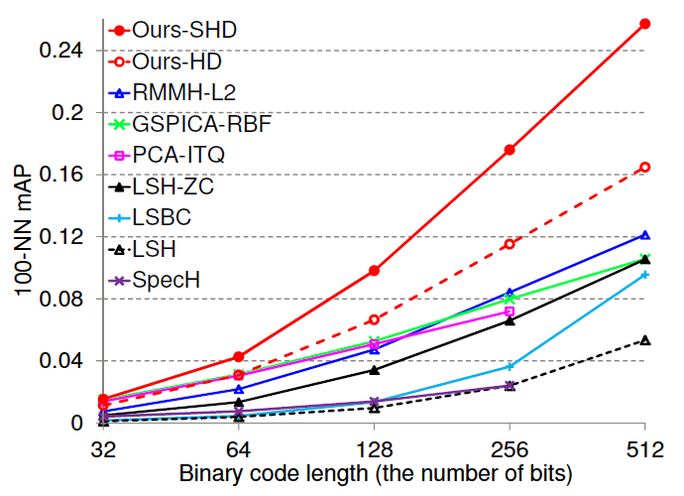
Spherical Hashing Performance
1 Million Images: GIST 384-D features

Slide 32

Point-to-Point Search vs.
Point-to-Hyperplane Search
normal
vector
nearest
neighbor
nearest
neighbor
hyperplane
query
point query
Notes:
Point-to-hyperplane search is rarely studied, but important to a lot of CV/ML problems such as margin-based active learning.

Slide 33


Hashing Principle:
Point-to-Hyperplane Angle
Notes:
1) The original problem searches the database point with the shortest point-to-hyperplane distance D. To derive provable hashing, the hyperplane hashing methods find the database points with small point-to-hyperplane angles alpha.

Slide 34
Bilinear Hashing
Liu, Jun, Kumar, Chang, ICML12
Bilinear-Hyperplane Hash (BH-Hash)
query normal w or
database point x
2 random projection vectors
bilinear hash bit: +1 for || points, -1 for ┴ points

Slide 35



A Single Bit of Bilinear Hash
x1
u
v
1
x2
-1
-1
1
// bin
┴ bin
Notes:
Discard nearly // bin, keep nearly ┴ bin.

Slide 36


Theoretical Collision Probability
highest collision probability for active hashing
Double the collision prob
Jain et al. ICML 2010

Slide 37

Active SVM Learning with Hyperplane Hashing
Linear SVM Active Learning over 1 million data points
Notes:
LBH: learning based Bilinear Hash. Fit pair wise labels
Data set: news document categories

Slide 38
Summary
Compact hash code useful
  Fast computing on light clients
  Compact: 20-64 bits per data point
  Fast search: O(1) or sublinear search cost
Recent work shows learning from data distributions and labels helps a lot
  PCA hash, graph hash, (semi-)supervised hash
Novel forms of hashing
  spherical, hyperplane hashing

Slide 39
Open Issues
Given a data set, predict hashing performance (He, Kumar, Chang ICML ‘11)
  Depend on dimension, sparsity, data size, metrics
Consider other constraints
  Constrain quantitation distortion
  (Product Quantization, Jegou, Douze, Schmid ’11)
  Verifying structure, e.g., spatial layout
  Higher order relations
  (rank order, Norouzi, Fleet, Salakhutdinov, ‘12)
Other forms of hashing beyond point-to-point search

Slide 40
References
(Hash Based Mobile Product Search)
J. He, T. Lin, J. Feng, X. Liu, S.-F. Chang, Mobile Product Search with Bag of Hash Bits and Boundary Reranking, CVPR 2012.
(ITQ: Iterative Quantization)
Y. Gong and S. Lazebnik, Iterative Quantization: A Procrustean Approach to Learning Binary Codes, CVPR 2011.
(SPICA Hash)
J.He, R. Radhakrishnan, S.-F. Chang, C. Bauer. Compact Hashing with Joint Optimization of Search Accuracy and Time. CVPR 2011.
(SH: Spectral Hashing)
Y. Weiss, A. Torralba, and R. Fergus. "Spectral hashing." NIPS, 2008.
(AGH: Anchor Graph Hashing)
W. Liu, J. Wang, S. Kumar, S.-F. Chang. Hashing with Graphs, ICML 2011.
(SSH: Semi-Supervised Hash)
J. Wang, S. Kumar, S.-F. Chang. Semi-Supervised Hashing for Scalable Image Retrieval. CVPR 2010.
(Sequential Projection)
J, Wang, S. Kumar, and S.-F. Chang. "Sequential projection learning for hashing with compact codes." ICML, 2010.
(KSH: Supervised Hashing with Kernels)
W. Liu, J. Wang, R. Ji, Y. Jiang, and S.-F. Chang, Supervised Hashing with Kernels, CVPR 2012.
(Spherical Hashing)
J.-P. Heo, Y. Lee, J. He, S.-F. Chang, and S.-E. Yoon. "Spherical hashing." CVPR, 2012.
(Bilnear Hashing)
W. Liu, J. Wang, Y. Mu, S. Kumar, and S.-F. Chang. "Compact hyperplane hashing with bilinear functions." ICML, 2012.

Slide 41
References (2)
(LSH: Locality Sensitive Hashing)
A. Gionis, P. Indyk, and R. Motwani. "Similarity search in high dimensions via hashing." In Proceedings of the International Conference on Very Large Data Bases, pp. 518-529. 1999.
(Difficulty of Nearest Neighbor Search)
J. He, S. Kumar, S.-F. Chang, On the Difficulty of Nearest Neighbor Search, ICML 2012.
(KLSH: Kernelized LSH)
B. Kulis, and K. Grauman. "Kernelized locality-sensitive hashing for scalable image search." ICCV, 2009.
(WeaklySH)
Y. Mu, J. Shen, and S. Yan. "Weakly-supervised hashing in kernel space." CVPR, 2010.
(RBM: Restricted Boltzmann Machines, Semantic Hashing)
R. Salakhutdinov, and G. Hinton. "Semantic hashing." International Journal of Approximate Reasoning 50, no. 7 (2009): 969-978.
(BRE: Binary Reconstructive Embedding)
B. Kulis, and T. Darrell. "Learning to hash with binary reconstructive embeddings." NIPS, 2009.
(MLH: Minimal Loss Hashing)
M. Norouzi, and D. J. Fleet. "Minimal loss hashing for compact binary codes." ICML, 2011.
(HML: Hamming Distance Metrics Learning)
M. Norouzi, D. Fleet, and R. Salakhutdinov. "Hamming Distance Metric Learning." NIPS, 2012.

Slide 42
Review Slides

Slide 43


Popular Solution: K-D Tree
Tools: Vlfeat, FLANN
Threshold in max variance or random dimension at each node
Tree traversing for both indexing and search
Search: best-fit-branch-first, backtrack when needed
Search time cost: O(c*log n)
But backtrack is prohibitive when dimension is high
(Curse of dimensionality)

Slide 44
Popular Solution: Hierarchical k-Means
[Nister & Stewenius, CVPR’06]
k: # codewords
b: # branches
l: # levels
Divide among clusters in each level hierarchically
Search time proportional to tree height
Accuracy improves as # leave clusters increases
Need of backtrack still a problem (when D is high)
When codebook is large, memory issue for storing centroids
44
K. Grauman, B. Leibe
Notes:
Memory for storing cluster centroids (b/(b-1))*(k-1)*D
Search time proportional to tree height (l*b*D)
k: # of leave clusters, each node (leave and intermediate) stores centroid
b: branching factor, l: tree height

Slide 45




Product Quantization
Jegou, Douze, Schmid, PAMI 2011
………………
feature dimensions (D)
$$x^{1}$$
$$⋯$$
$$x^{m}$$
divide to
m subvectors
k^{1/m} clusters in each subspace
Create big codebook by taking product of subspace codebooks
Solve storage problem, only needs k^{1/m} codewords
  e.g. m=3, needs to store only 3,000 centroids for a one-billion codebook
Exhaustive scan of codewords becomes possible -> avoid backtrack
$d(q,w_{i})$=$d\left(q, {w_{i}}_{}^{1}\right)+d\left(q, {w_{i}}_{}^{2}\right)+d(q, {w_{i}}_{}^{3})$
Notes:
k: # of codewords
Need to store centroids
Source coding (Lloyd quantizer): estimation error of distance from query to database point is bounded by quantizer MSE
PAMI11: use a coarse quantization first. Then use product quantization to index the residue error

